Slide 1

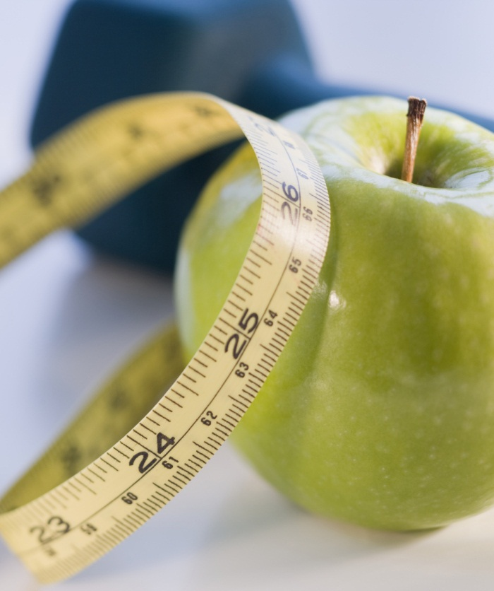

Does Happiness impact Life Expectancy, what impacts Happiness and Life Expectancy?
Exploring the Relationship through Data Visualization
Paula Beckett, Juanita Sands, Joey Zheng, Cameron DIFalco
Notes:
Cameron –
Hi All, Today our group will be discussing the connection between happiness and life expectancy and why this been the subject to a number of studies and research questions.
While the relationship between the two is complex and multifaceted, there is evidence to suggest that happiness and life expectancy are indeed interconnected.
Our first data set is from the World Health Organisation (WHO) as they keep track of a number of health-related factors for all countries. The other is a well trusted data set from Kaggle which refers to the Happiness vs Corrpution of a country and if there is any correlation. Both Data sets overlap over the year 2015 so we are using this year to base our data and will be using other years of the data sets to assist in building trends and a greater picture of how these countries change over time.

Slide 2


Context of the Work
The purpose of this presentation is to draw a conclusion on how happiness can impact long Gevity, more importantly from a statistical point of view, is there any correlation?
There have been many studies on this topic, however in our opinion they are not wholisitc and sometimes push an underlying narrative and have varied results.
We are evaluating multiple data sources today to work through this questions and provided a clear and concise answer to you on how your happiness can impact your ability to live a long and fruitful life.

Slide 3

Understanding the connection between happiness and life expectancy
What Impacts Happiness
Positive emotions
Lower stress levels
Social support and relationships
Positive lifestyle choices
What Impacts Life Expectancy
Healthy lifestyle
Access to health care/ disease prevention
Education and knowledge
Mental well-being
Notes:
Juanita –
What Impacts Happiness:
Positive Emotions: Cultivating positive emotions such as joy, gratitude, and contentment can significantly impact happiness and overall well-being.
Lower Stress Levels: Managing and reducing stress through techniques like mindfulness and self-care can contribute to increased happiness and improved mental health.
Social Support and Relationships: Strong social connections and supportive relationships with family, friends, and communities play a crucial role in fostering happiness and providing a sense of belonging.
What Impacts Life Expectancy:
Healthy Lifestyle: Engaging in regular exercise, maintaining a balanced diet, and avoiding harmful habits like smoking and excessive alcohol consumption can positively impact life expectancy.
Access to Health Care/Disease Prevention: Ensuring access to quality healthcare services, early disease detection, and preventive measures like vaccinations can contribute to a longer and healthier life.
Education and Knowledge: Higher levels of education and access to knowledge enable individuals to make informed decisions about their health, adopt healthier behaviors, and seek appropriate medical care.
Mental Well-Being: Addressing and maintaining good mental health through stress management, seeking professional help when needed, and promoting overall well-being can have a positive impact on life expectancy.

Slide 4
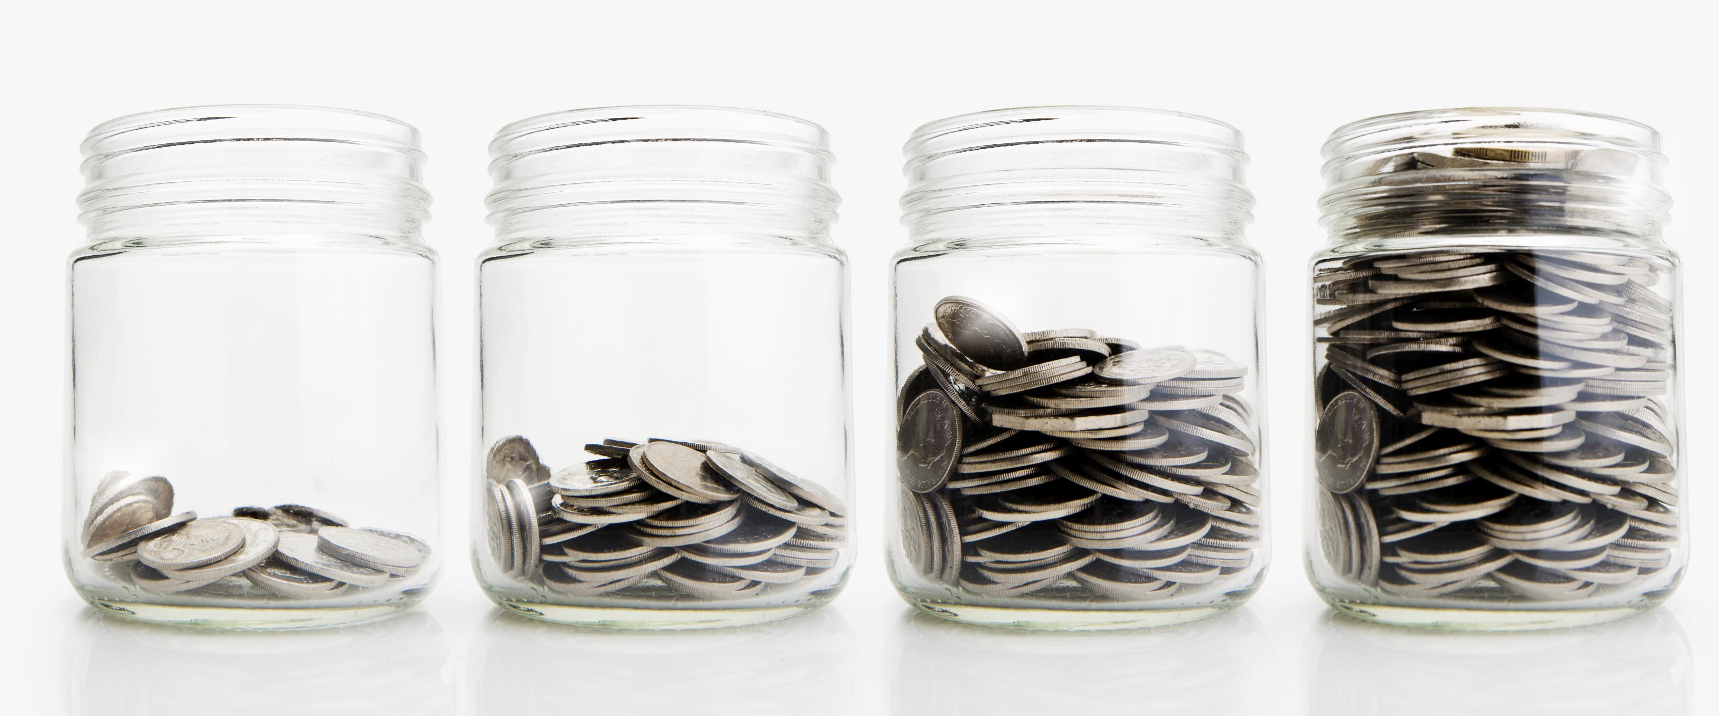
GDP vs Happiness OR Long Life
Insights
1
2
3
Possible Solutions
1
2
3

Slide 5
GDP vs Happiness OR Long Life
Insights
1
2
3
Possible Solutions
1
2
3

Slide 6

Joey Question Health
Insights
1
2
3
Possible Solutions
1
2
3

Slide 7
Joey Question Health
Insights
1
2
3
Possible Solutions
1
2
3

Slide 8
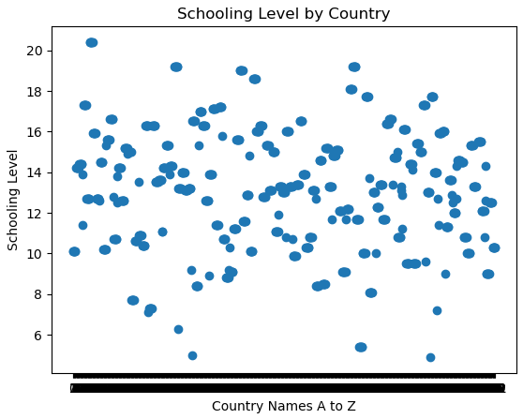
Schooling Year Level by Country
Insights
1
2
3
Possible Solutions
1
2
3

Slide 9
Schooling Year Level by Country
Insights
1
2
3
Possible Solutions
1
2
3

Slide 10

Paula Question
First bullet point here
Second bullet point here
NO correlation but still important because X

Slide 11
Paula Question
First bullet point here
Second bullet point here
NO correlation but still important because X

Slide 12

Top 5 Ranked Countries from our Data Sets
Top 5 of Each Ranked and if there are doubles in each list we call out
For visual
For visual
For visual
For visual
For visual
For visual
For visual
For visual

Slide 13

Conclusion – Summary?
Write-up summarises major findings and implications at a professional level (5 points)
Each question in the project proposal is answered with precise descriptions and findings (5 points)
Findings are strongly supported with numbers and visualisations (5 points)
Each question response is supported with a well-discerned statistical analysis from lessons (e.g., aggregation, correlation, comparison, summary statistics, sentiment analysis, and time series analysis) (5 points)
GDP vs Long Life?
Joey – Health
Cameron – Schooling
Paula – No Correlation
Overall thoughts on correlation

Slide 14

Thank You Cameron, Joey, Juanita and Paula

